Slide 1
The APEX Program Advancement through Pardons and Expungements

Slide 2
Introduction
Dominique Truitt
New Castle County Coordinator
302-761-8256 (Office)
302-333-7605 (Cell)
Dominique.Truitt@delaware.gov
Andrew Duncan
Downstate Coordinator
Kent County: 302-233-6462
Sussex County: 302-333-7600
Andrew.Duncan@delaware.gov

Slide 3
Before We Get Started: Do You Qualify for our program?
A) You have never been convicted of an adult offense in Delaware.
OR
You have been convicted of an adult offense, but you have not been arrested, incarcerated, or on probation or parole in the past 3 years.
B) You have no pending or unresolved charges.
C) Your offenses are in the State of Delaware.
Notes:
Before we get started…

Slide 4
What appears on a Delaware state criminal history report??
…..EVERYTHING

Slide 5
UNDERSTAND THE DIFFERENCE
“I have been charged”
“I have been convicted”
Any offense can appear on one’s record; even if the charge was dismissed.
The “Date of Arrest” will appear one one’s record; even if a physical arrest did not take place.
The individual was either “found guilty” or “pled guilty” to a charge placed against them.
In most cases, one receives a sentence of probation, incarceration, fines, restitution, community service, etc.

Slide 6
Examples of criminal dispositions
Guilty- convicted of a misdemeanor and/or felony.
Dismissed-case is terminated; no guilty findings.
Nolle Prosequi- Latin phrase meaning “will no longer prosecute”; non-conviction.
Probation Before Judgment(PBJ) - a non-conviction contingent upon successful completion of probation.
First Offender-type of diversion typically offered to one with no previous criminal record; non-conviction.
Juvenile found delinquent-a minor that is found guilty/adjudicated.

Slide 7
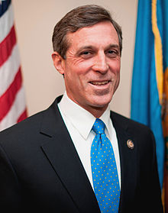
PARDONS Governor john carney

Slide 8
What is a PARDON?
Pardons
A PARDON is an official statement of forgiveness by the Governor.
The Governor issues an official, signed letter to the pardoned individual.
It indicates that the recipient is reformed, living a productive life, and no longer a threat to society.

Slide 9
What Does a PARDON Do?
Pardons
A PARDON can restore your civil rights, such as the rights to vote, hold public office, and own a firearm.
A PARDON changes your criminal record to indicate that your offenses have been pardoned.
A PARDON may be viewed favorably by employers and licensing agencies.

Slide 10
What a PARDON Does NOT Do
Pardons
A PARDON does not erase the offenses from your criminal record.

Slide 11
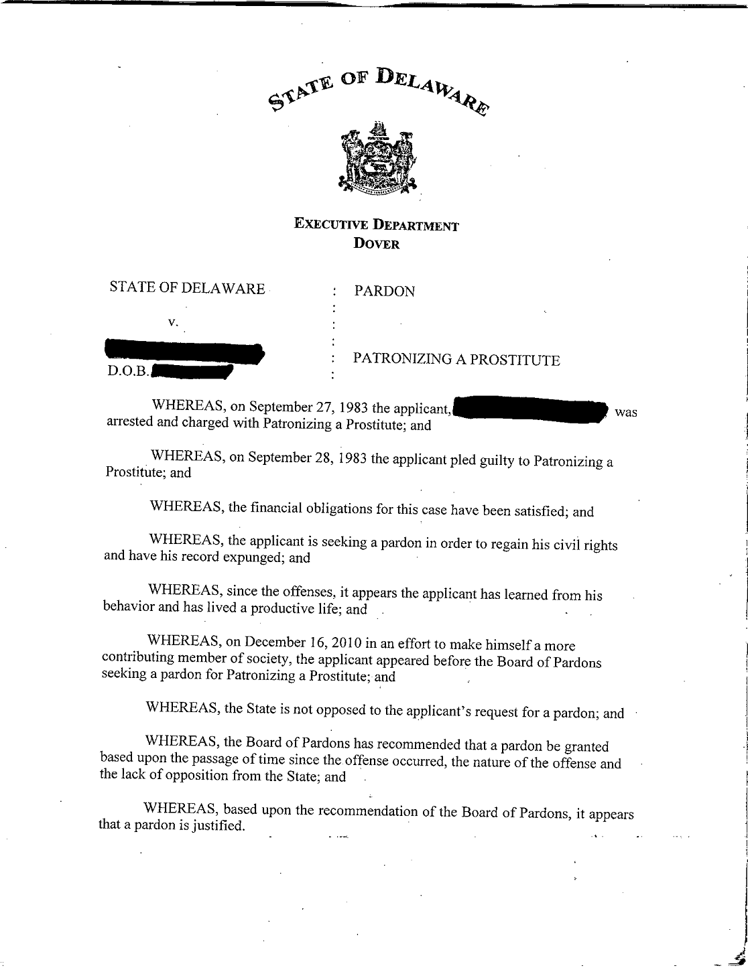

Slide 12
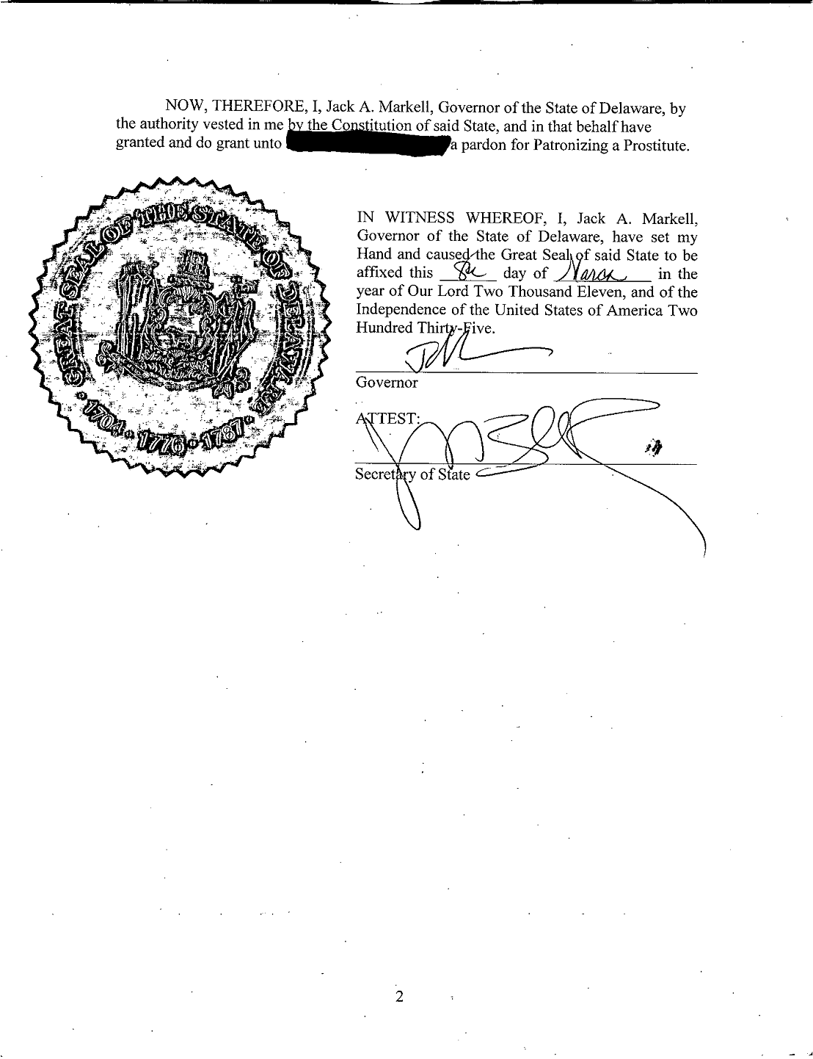

Slide 13
Who is ELIGIBLE for a PARDON?
Pardons
To be ELIGIBLE for a pardon:
Your convictions must be in the State of Delaware, and not federal or out-of-state.
You must have completed all phases of your sentence(s), including probation and parole.
You may not be delinquent on payment of any restitution, fees, or fines from your offenses.
You may not have any pending charges.

Slide 14
The CRITERIA
Pardons
You are more likely to receive a pardon if:
There has been a significant lapse of time since your most recent offense or arrest.
You accept responsibility – you acknowledge guilt, admit that you were wrong, & understand how you hurt others.
You demonstrate remorse – you show regret for your actions and are apologetic to those affected by your actions.
You have demonstrated good citizenship – volunteering, church involvement, supporting a family, employment, etc.
You have pursued self-improvement – getting an education, completing rehab, changing your people & places, etc.

Slide 15
The PROCEDURES
Pardons
The granting of a PARDON requires two actions:
The Board of Pardons must recommend your application to the Governor.
AND
The Governor must approve your pardon

Slide 16
Timeline
Pardons
The Board of Pardons meets monthly. However, once you submit your application, you will need to wait at least 6 months to appear for a hearing.
If the Board recommends you for a pardon, the GOVERNOR will decide whether to grant your pardon about 6 months later.
All in all, the whole process from beginning to end can take well over a year.

Slide 17
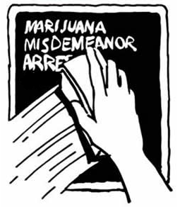
EXPUNGEMENTS

Slide 18
What is an Expungement?
Expungements
An EXPUNGEMENT seals a criminal record, so that it does not appear on state-run background checks.

Slide 19
What Can Be Expunged
Expungements
You may be eligible to apply for expungement in four scenarios:
Scenario #1: Charges terminated in your favor:
These are charges that do not lead to a guilty conviction.
You are not likely to get these charges expunged if you
have any convictions on your record at all.

Slide 20
What Can Be Expunged
Expungements
You may be eligible to apply for expungement in four scenarios:
Scenario #2: Pardoned misdemeanor convictions
If you successfully obtain a pardon, you may be able to apply to expunge your misdemeanor convictions.
However, adult felony convictions may not be expunged, even if they are pardoned.

Slide 21
What Can Be Expunged
Expungements
You may be eligible to apply for expungement in four scenarios:
Scenario #3: Juvenile Charges.
Your eligibility depends on the number of juvenile charges, the severity of the offenses, & the time elapsed since the offenses.
You are not likely to be eligible if you have both adult convictions as well as juvenile charges (unless you receive a pardon).

Slide 22
What Can Be Expunged
Expungements
You may be eligible to apply for expungement in four scenarios:
Scenario #4: Single Possession of Marijuana Conviction
This means that any person convicted of a single offense of cannabis possession, use, or consumption, who would otherwise be eligible for a mandatory expungement under 11 Del. C. § 4373 will be eligible despite their conviction when they were not prior to SB197’s passage.

Slide 23
What can be expunged
Expungements
Please note that this is only a general description of Delaware’s policies on expungement eligibility.
There are several further restrictions on eligibility, as dictated by the relevant laws and regulations.

Slide 24
APPLYING
Expungements
When you request an Expungement/Pardon Background Check from the State Bureau of Identification (SBI), they may be able to inform you of whether you are eligible to apply for expungement.
If you are eligible, you will probably still need to apply to the Superior Court or Family Court, which will decide whether or not to grant the expungement.

Slide 25
NEXT STEPS

Slide 26
The APEX Process
STEP 1: Orientation Meeting
STEP 2: Obtain your SBI Criminal History Report
STEP 3: SBI Report Preparation
STEP 4: Obtain Court Documents (Pardon Only)
STEP 5: Interview
STEP 6: Hearing Preparation (Pardon Only)
STEP 7: Your Pardon Hearing (Pardon Only)
Notes:
Steps 2, 4 and 7: the client completes on their own
Mention: We are not lawyers, we cannot obtain documents for you, make statements for you, or represent you in the hearing. We are here to assist you with applying and guide you through the process, we cannot complete the process for you.

Slide 27
COSTS
While APEX is a free service, you will incur costs from the State Police and the courts:
PARDON
Criminal History Report: $52.00
Court Records: $7 - $45 for each case
If you have certain serious offenses, you may need to pay for a Mental Health Evaluation.
EXPUNGEMENT
Criminal History Report: $52.00
Filing Fee: $75 *
If you are a client of a government social service agency, you may be able to request that it subsidize the cost.
Notes:
Steps 2, 4 and 7: the client completes on their own
Mention: We are not lawyers, we cannot obtain documents for you, make statements for you, or represent you in the hearing. We are here to assist you with applying and guide you through the process, we cannot complete the process for you.

Slide 28
Questions?

